Slide 1
Customer Analysis
Using SQL And Tableau

Slide 2
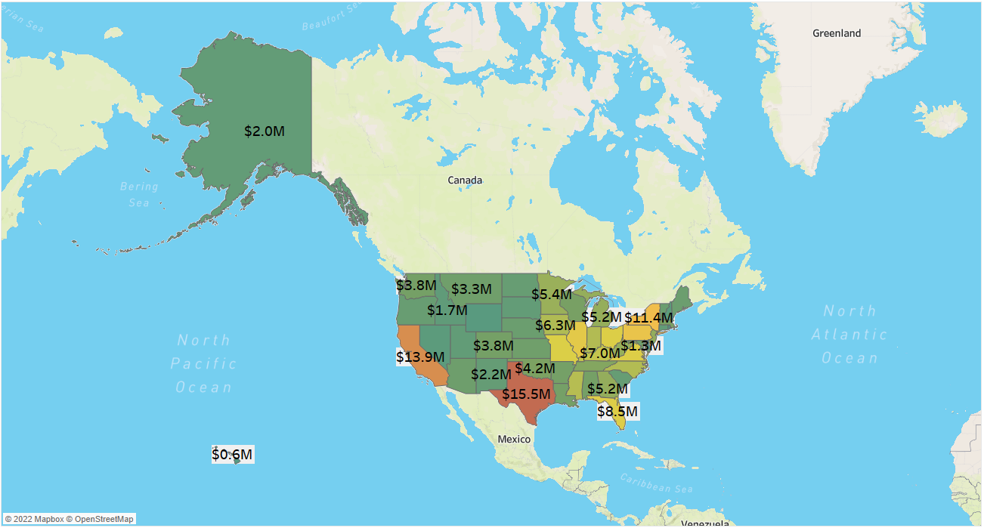
Task1:- Revenue per state
In this task I have shown revenue state-wise.

Slide 3
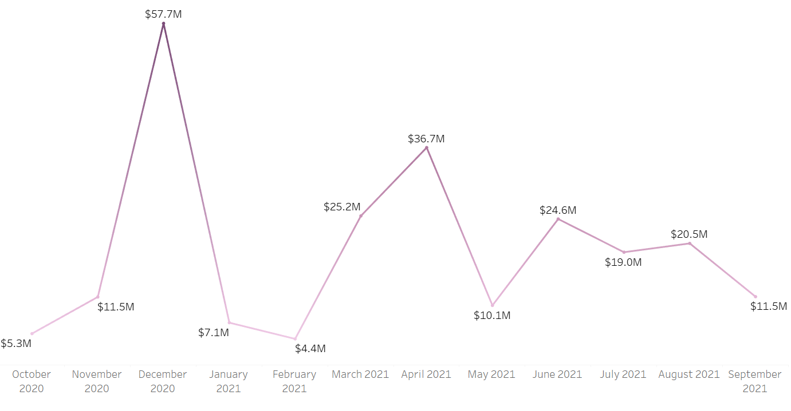
Task2:- Revenue based on Month of the year
In this task I have shown revenue month-wise.

Slide 4
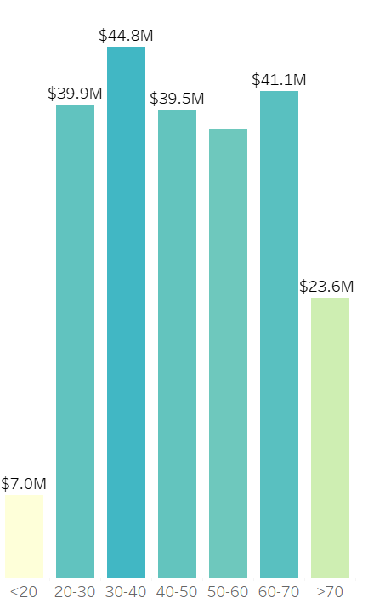
Task3:- Revenue Based on Age
In this task I have shown revenue age-wise.

Slide 5
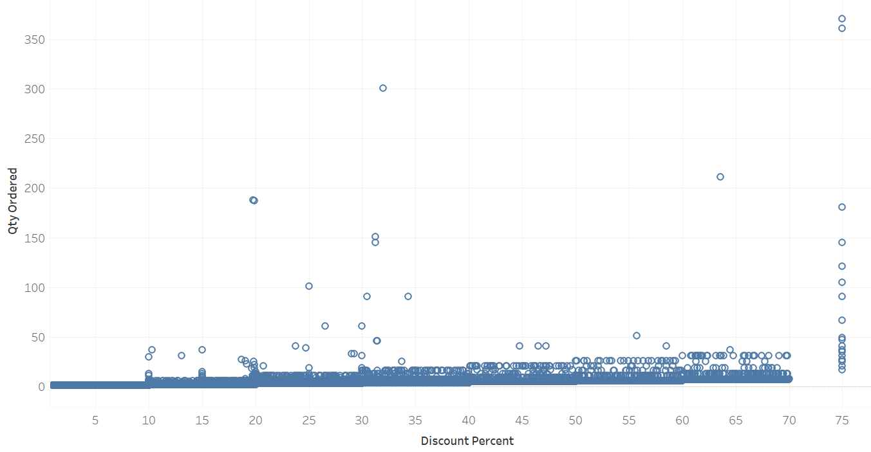
Task4:- Quantity- Discount Percentage Correlation
In this task I have shown discount percentage with respect to order quantity.

Slide 6
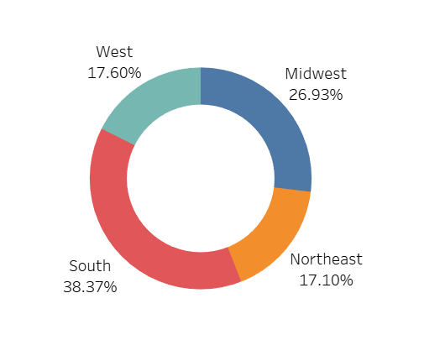
Task5:- Percentage of Revenue per Region
In this task I have shown the percentage of revenue region-wise.

Slide 7
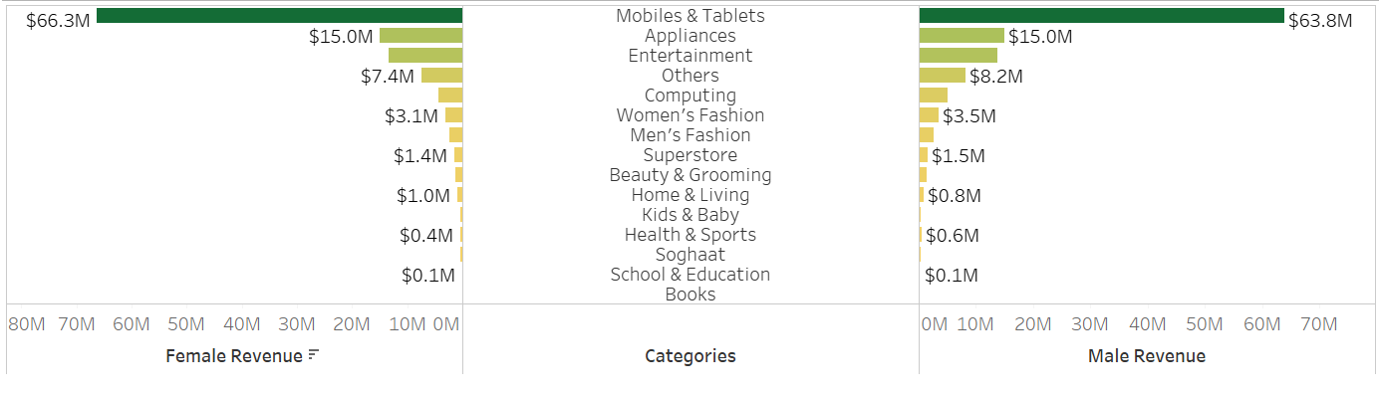
Task6:- Revenue per category per Gender
In this task I have shown per category and per gender.

Slide 8
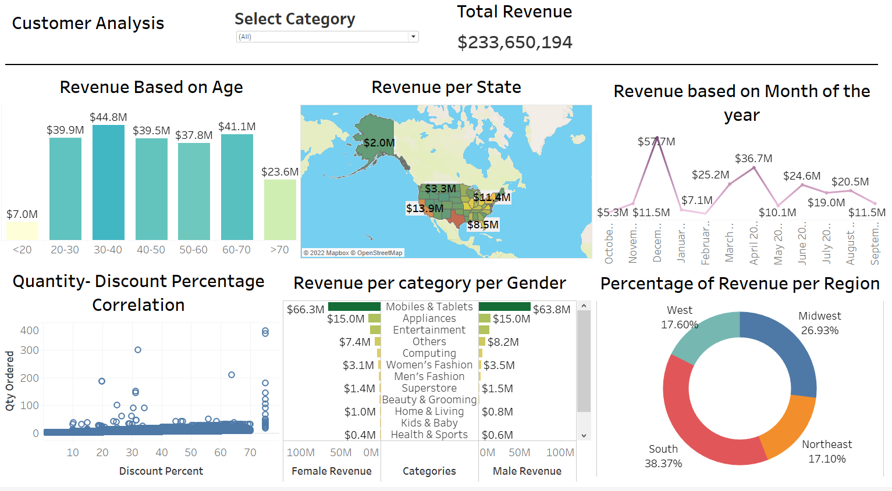
Summary

Slide 9
Thank You ☺
Vipin Chaudhary
iamvipin.it@gmail.com

